Slide 1
Xylem Analytics Environmental Monitoring Systems & Solution

Slide 2
Water Infrastructure :
Water Transport
Water Transport
Drivers
Water Treatment
Depleting Water Supply
Tightening Regulations
Aging Infrastructure
Water Pollution
Climate change
Water Sources
Water Usage
Wastewater Treatment
Water Transport
Wastewater Transport
Water is a key sustainability issue. Xylem is a water technology company.
Notes:
We span the water cycle
Xylem has product and application expertise that span the entire water cycle, which can be broken down into two halves - water infrastructure and water applications.
Having a huge footprint on both sides of the water cycle gives us a balanced portfolio and presents opportunities for us to create solutions for customers no matter where they are in this loop.
On the Water Infrastructure side of the water cycle, we are helping customers collect water from a source and distribute it to users, and then helping them return wastewater back to the environment. This involves three closely linked applications – transport, treatment and testing of water – for two types of customers: public utilities and industrial facilities.
On the Applied Water side of the water cycle, we are focused on all the applications – or uses – of water in our daily lives. The customers here can be put into three major categories: Building services (residential, commercial), industrial and agriculture.

Slide 3
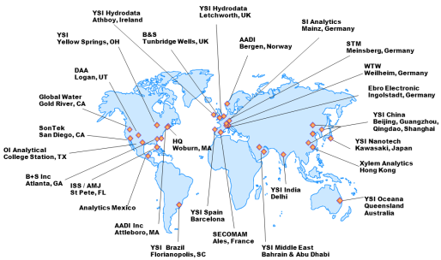
Xylem Analytics Overview
$300m in revenue
1,200 Employees worldwide
Headquarters-Woburn MA
Analytical Solutions for Water
World class brands

Slide 4
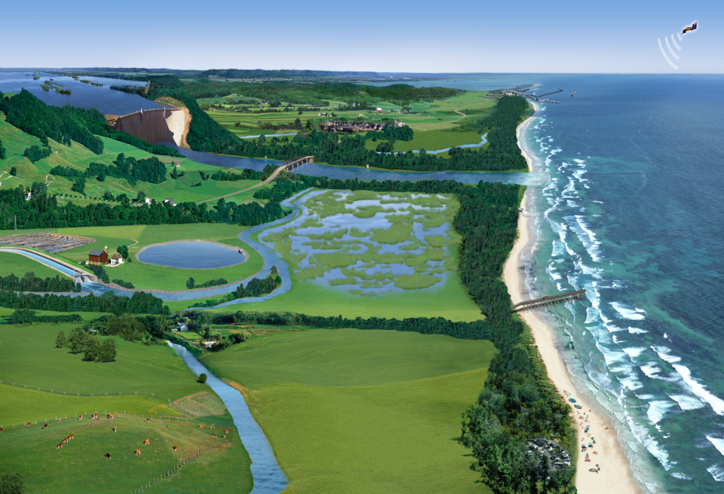
Surface Water Monitoring
Coastal Monitoring
River Monitoring
Lake Monitoring
Wetland Monitoring
Flood Monitoring and early warning

Slide 5
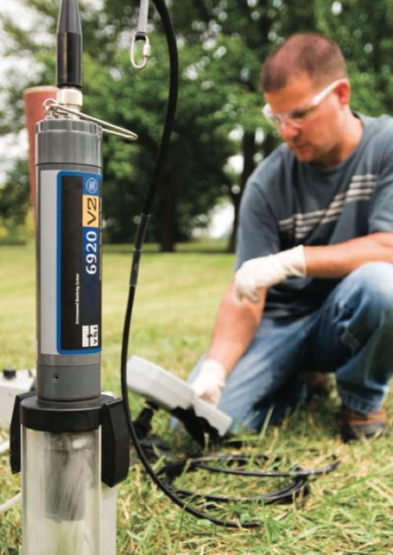
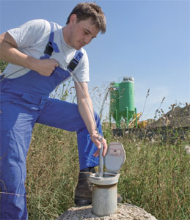
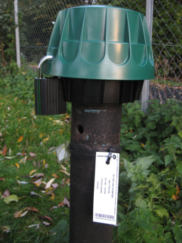
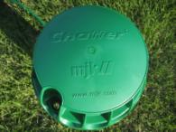
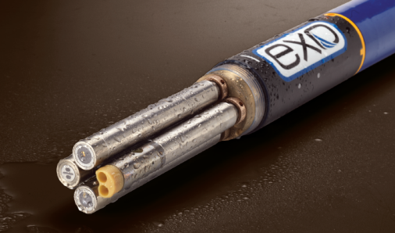
Ground Water Monitoring

Slide 6
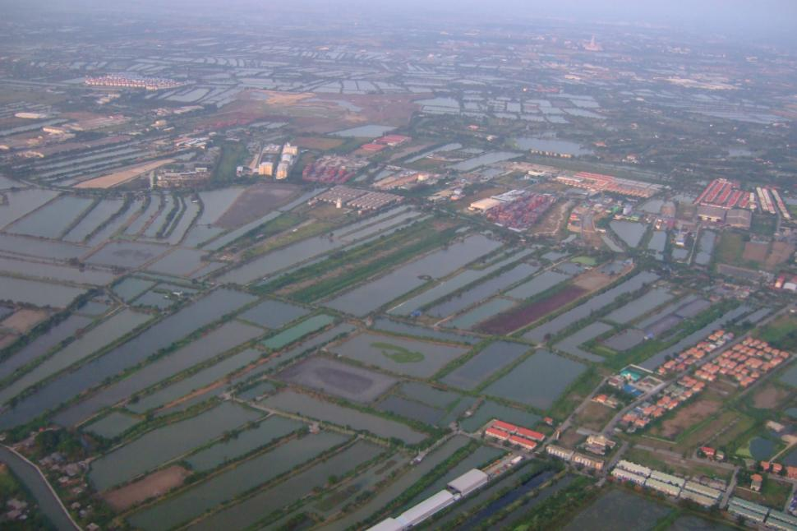
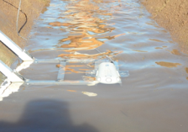
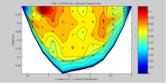
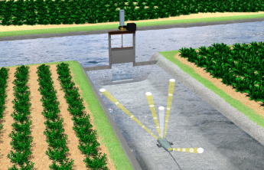
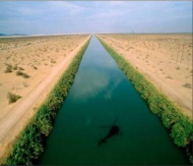
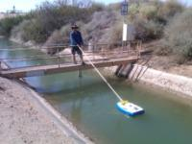
Irrigation & water channels

Slide 7
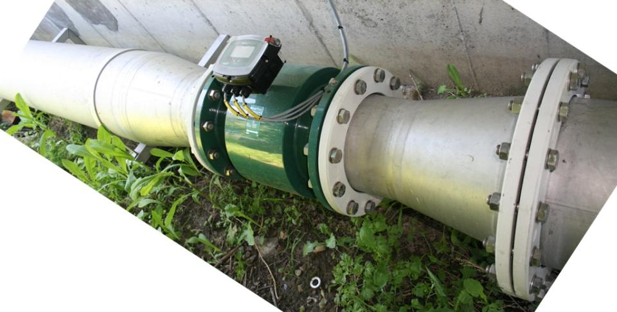
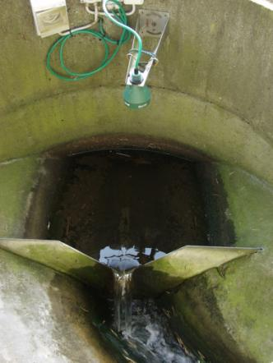
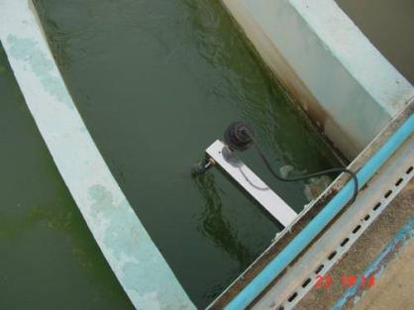
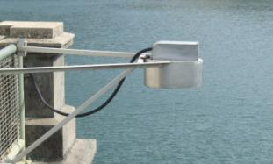
Drinking Water & Water Reservoirs

Slide 8
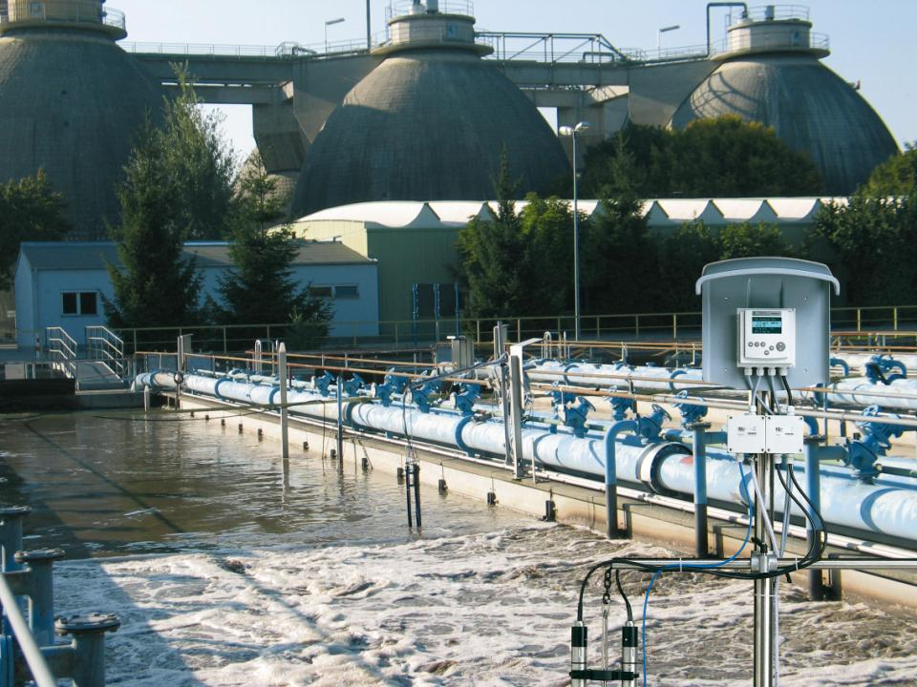
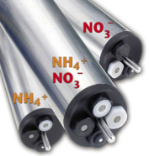
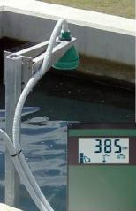
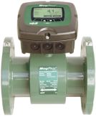
Waste Water Monitoring and Control

Slide 9
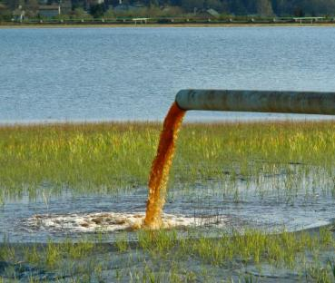
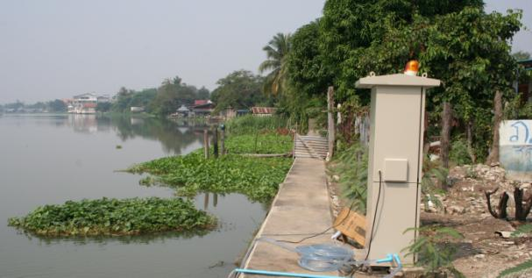
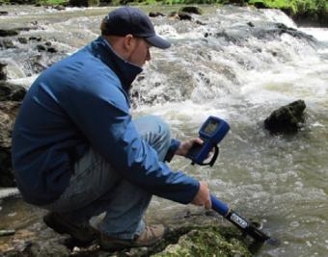
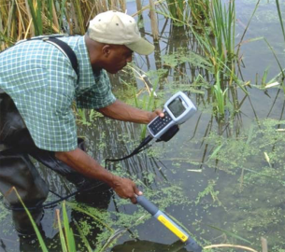
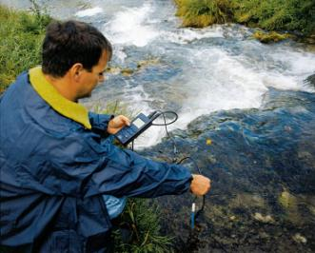
Effluent & River Monitoring

Slide 10
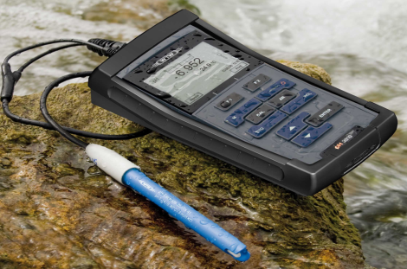
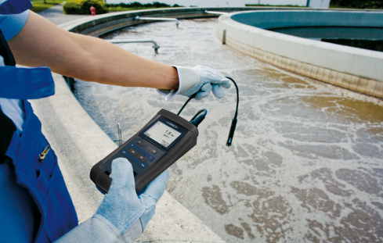
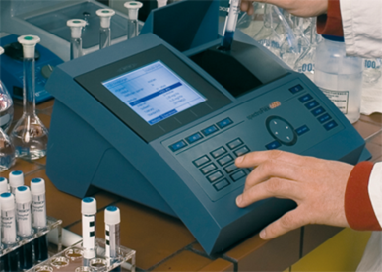
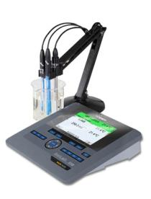
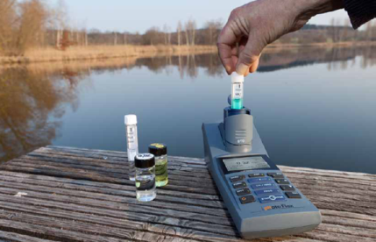
Water Lab-Analysis

Slide 11
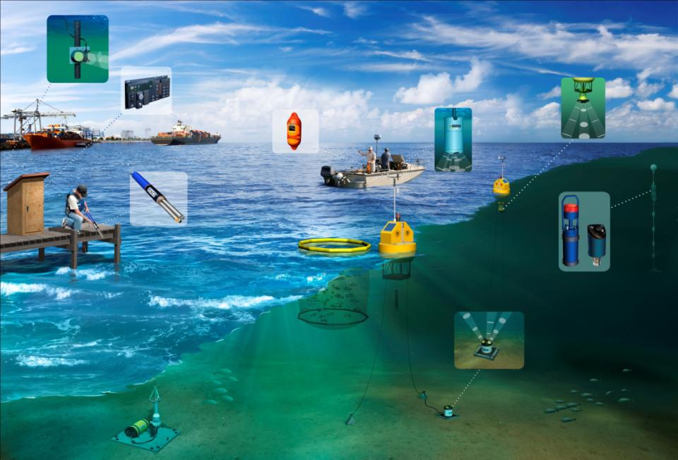
Sea Water Monitoring

Slide 12
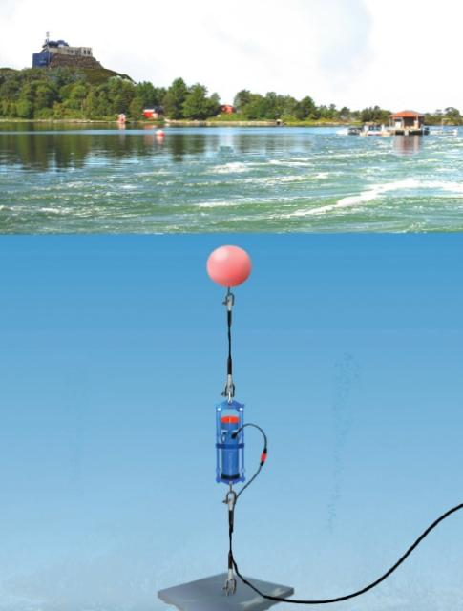
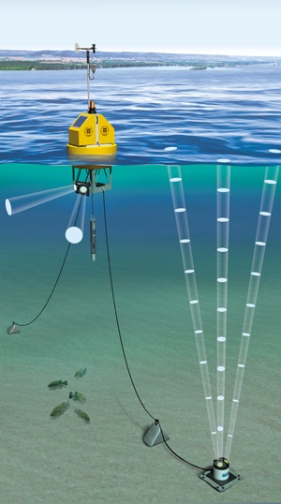
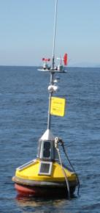
Sea Water Monitoring
Oceanography
Coastal Monitoring

Slide 13
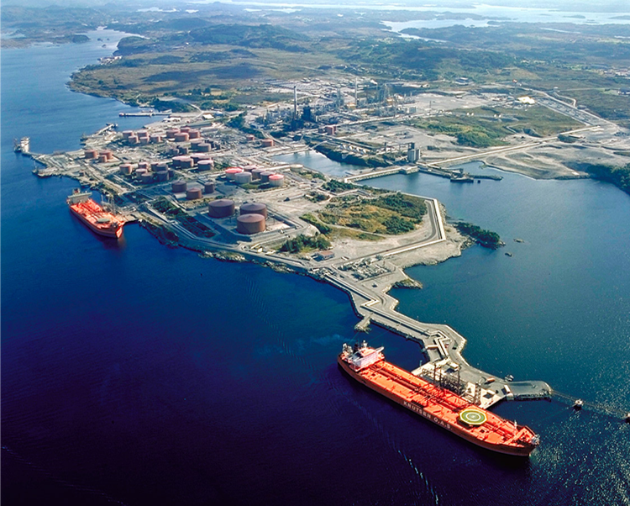
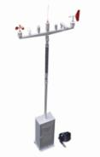
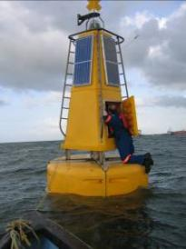
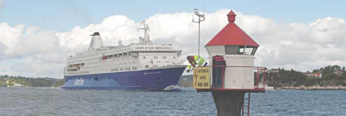
Harbor control

Slide 14
Systems for Hydrology
FlowTracker
Instantaneous point velocity/discharge measurement by traditional wading gauging
RiverSurveyor & HydroSurveyor
Instantaneous discharge measurement with velocity profiles (ADP/ADCP) and channel bathymetry
Argonaut/IQ
Permanent or semi-permanent continuous velocity/discharge measurement. Channel edge (side looker) or bed mounted (up looker)

Slide 15
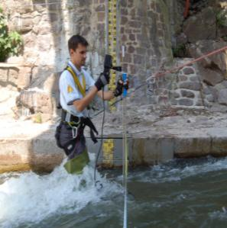
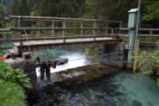
Wading Measurements - FlowTracker
proven
accurate
User friendly
rugged
adaptable

Slide 16
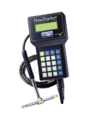
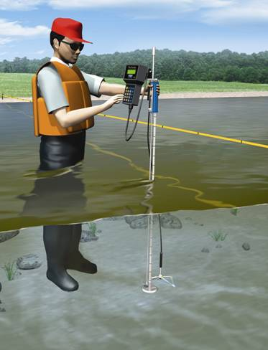
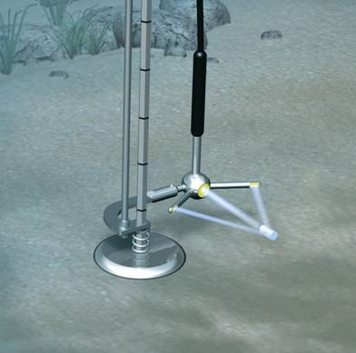
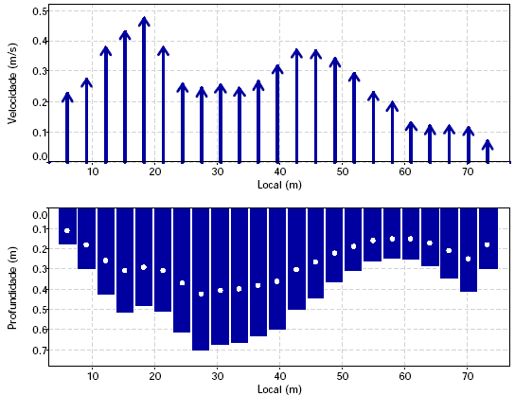
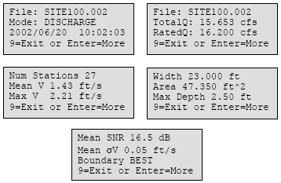
Wading Measurements

Slide 17
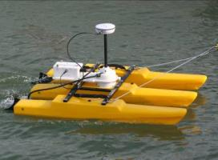
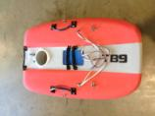
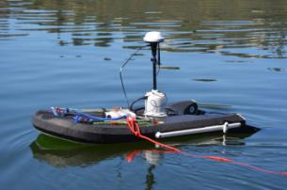
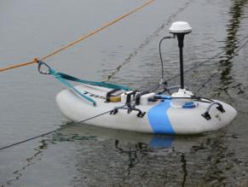
Floating platforms tethered boats
Torrentboard
Std & Mini
Europe
Hydroboard II
USA
OceanScience
Tri-hull - USA

Slide 18
Cableway I

Slide 19
Cableway remote controls

Slide 20
Bridge

Slide 22
Hydrosurveyor M9:
BATHYMETRIC MAPPING
Bathymetric mapping of reservoirs, lakes, rivers
Velocity mapping
Understand sediment build-up in reservoirs
Measure erosion downstream of dams and bridge pilings
Notes:
Let's Solve Water: Our Tagline and Our Goal
Water is the global challenge that will define the 21st century.
Many people around the world live and work in areas that are either experiencing or facing threats to their water supplies and water security.
Water scarcity is reaching crisis proportions. Environmental issues – including droughts and pollution – and aging infrastructure, such as leaking pipes and inefficient pump systems, are accelerating the problem.
At the same time, population growth and urbanization are creating increased need for the shrinking water resources. It's a supply-and-demand challenge on a global scale, and the issues that are causing it are complex, urgent and interrelated. At Xylem, we have the size, scope and focus to address this challenge.
Many of our competitors have businesses in other markets, but we are a "pure play" water technology company. We are focused on solving customers’ pressing and long-term water issues. And that focus is and will be a strength for our company going forward.
Xylem is uniquely positioned to address complex water issues.

Slide 23
Continuous Velocity and ‘Flow’ Measurement
Continuous Discharge Measurement
Argonaut ADV
IQ, IQ+
Argonaut SL3000 (& SL500 & SL1500)
IQ Pipe
Argonaut XR

Slide 24
SonTek IQ – example installations

Slide 25
breaking the SONDE barrier
EXO
Advanced Water Quality Monitoring Platform
3-5-2012
Notes:
YSI’s new advanced sonde platform

Slide 26
Notes:
EXO represents the work of over 30 engineers over 3 years.
We did not “redesign” a sonde, we started from scratch and worked with customer feedback and our own experience. We’ve found plenty of new materials that are better suited for long-term monitoring.

Slide 27
EXO Sondes
Notes:
EXO1: Sampling and ground water Product, 4 ports
EXO2: Continuous Monitoring Product, 6 ports plus wiper port and AUX port (AUX port still under development, at launch March 2012 will have limited functionality; in the future adapters for third-party sensors will be supported.)
Double O-Ring Seals throughout
Wet-mate connectors throughout
Durable Xenoy Material
250m Depth Rating on all sensors and probes

Slide 28
Inside
Notes:
Metal Bulkhead (no stripping threads) and the sensor threads are replaceable
D-Batteries (2 and 4)
Built-in Bluetooth Communications
Magnetic Radio Switch
Visual State Indicators (blue and red lights) – On, Off, Logging Enabled, Bluetooth connected, Errors
Smart Ports
Data Logging – Standard
Batteries – Standard
(No Vented Level Sondes at release, other depths are ordered with the sonde – 10 meter, 100 meter, 250 meter)

Slide 29
Features You’ll Find Only with EXO
Assisted Calibration
Graphical KOR software speeds the calibration process while reducing reagent consumption
Auto-recognition
and set-up of all sensors with
background data routing
Titanium Sensors
with wet-mateable connectors and welded seals for deeper depths
Cable-free Operation
through the use of wireless communications
Biofouling Protection
with copper-alloy components and anti-fouling wipers
Smart QC
Automatically checks for faults and errors to ensure successful
deployments
Notes:
Please promote these features to build a brand around these lock-out specs.

Slide 30
Smart Ports
Flexible: ANY SENSOR, ANY PORT
Protection: AC Capacitive Coupling protects electrical circuitry
Notes:
Every Port is Identical – Any sensor can be installed into any port
(Except the AUX port and power/comms port)
Improved sonde flexibility
Illustrate capacitive coupling.

Slide 31
Smart Sensors
Notes:
All specs will meet or exceed YSI current standards
Smart Sensors
Each sensor will have factory calibrations so all will have exact same range and relative readings
Metadata
Cal Data
Firmware
Each Sensor is same length so measurements taken at exact same depth. Important for micro-structures! (depth sensor is offset)
User-replaceable locking nuts if stripping or damage occurs

Slide 32
Introducing the YSI ProDSS
Hybrid of market leading YSI Pro Series and YSI EXO sonde technology
Digital smart technology from the EXO
Same case design as Pro Series except with a black keypad
Proven case design is waterproof (IP67 rated), with or without battery cover or cable connected
Rubber over mold for better grip
Easy to hold, light weight and allows for one hand operation
Multi sensor calibration
3 year handheld warranty

Slide 33
ProDSS – a mix of two technologies
Smart, digital sensors – plug and play, automatically recognised by ProDSS handheld and enabled on display
Field worthy – titanium, laser welded sensors are rugged for the field
Replaceable tips lowering operational costs
2 year warranty on sensors, 1 year warranty on pH and pH/ORP sensing modules and 6 months on Ammonium, Nitrate and Chloride sensing modules

Slide 34
ProDSS – field worthy
IP67, waterproof
Durable cable carries 2-year warranty
No plastic connectors! Metal – military spec, locking cable connector and titanium retaining rings on sensor connector are made for the field.
GPS optional – log GPS coordinates with data for mapping in KorDSS

Slide 35
ProDSS – Smart handheld
On-screen help function
Real-time graphs
Multilingual
Large, non-volatile internal memory
> 100,000 data sets
Logging modes: single or continuous
Data tagging options:
100 site lists (station 1, station 2)
100 data ID tags (for example, project ID or other descriptor)
400 glp (good laboratory practice) calibration records
Proves accurate calibration and therefore functional sensor and accurate data collection
Password protection available
Improved autostable feature
Select % or absolute value change
Select number of samples needed to meet requirement
On-screen indicators

Slide 36
Xylem Analytics - Capabilities

Slide 37
End User : INDIRA GANDHI NAHAR PROJECT (IGNP) Contractor : MECHATRONICS SYSTEMS PVT. LTD.
Project Canal Flow Monitoring Project
Location Rajasthan
Technology Acoustic Doppler Technology
Xylem Offer SonTek Acoustic Doppler Technology based flow Monitoring at 96 locations with 4 M9s

Slide 38
End User : CENTRAL WATER COMMISSION Contractor : ESSEL SHYAM TELECOM LTD
Project CWC TELEMETRY PROJECT
Location India
Technology INSAT based TDMA Transmission
Xylem Offer 230+ units of WaterLOG make Dataloggers with INSAT transmission
based on TDMA technology

Slide 39
End User : MAHARASHTRA WATER RESOURCE DEPT. Contractor : MECHATRONICS SYSTEMS PVT. LTD.
Project RTDAS for Krishna & Bhīma River Basins
Location Maharashtra
Technology Data Acquisition & Acoustic Doppler
Xylem Offer 240 units of WaterLOG make Dataloggers, 16 Bubbler Sensors, 3
SonTek M9s

Slide 40
End User : NATIONAL INSTITUTE OF OCEAN TECHNOLOGY Contractor : ELEKTRONIK LAB, CHENNAI
Project Kalpasar baseline Survey Project
Location Gujarat Coast
Technology Current, Tide and Weather Monitoring
Xylem Offer 28 Tide & Weather Stations, WaterLOG 12 SonTek Argonaut MDs

Slide 41
End User : CHILIKA DEVELOPMENT AUTHORITY Contractor : ELEKTRONIK LAB, CHENNAI
Project Water Quality Monitoring Buoy System
with GSM/GPRS Telemetry and Related Services for Chilika Lake
Location Orissa
Technology Water Quality Monitoring buoys with telemetry to shore station
Xylem Offer 10 EMM 68 Buoys with 2 spare sonde

Slide 42
End User : CENTRAL RESEARCH INSTITUTE FOR
DRYLAND AGRICULTURE Contractor : NATIONAL COLATRAL MANAGEMENT SERVICES LTD
Project National Initiative on Climate Resilient Agriculture – AWS
Location India
Technology Weather Monitoring with GPRS Commn
Xylem Offer 100 WaterLOG Weather Stations

Slide 43
End User : NATIONAL CENTRE FOR SUSTAINABLE
COASTAL MANAGEMENT Contractor :
Project ICZM PROJECT
Location Chennai
Technology Coastal Current, Water Quality, Wave &
Tide monitoring
Xylem Offer 5 YSI EMM 68 Buoys with EXO Sonde 2 YSI EXO Sonde
4 SonTek ADCPs
4 SonTek Hydra
6 Aanderaa RCMs
6 Aanderaa WTR
3 Aanderaa DCS

Slide 44
End User : VARIOUS INDUSTRIES AFFECTED BY
CPCB REGULATIONS
Project Online Effluent Water Quality Monitoring System
Location All over India
Technology Online BOD / COD monitoring
Xylem Offer WTW IQSN System

Slide 45
Thank you!

